Slide 1

Money Challenge
of the Day
Grades 2-3

Slide 2

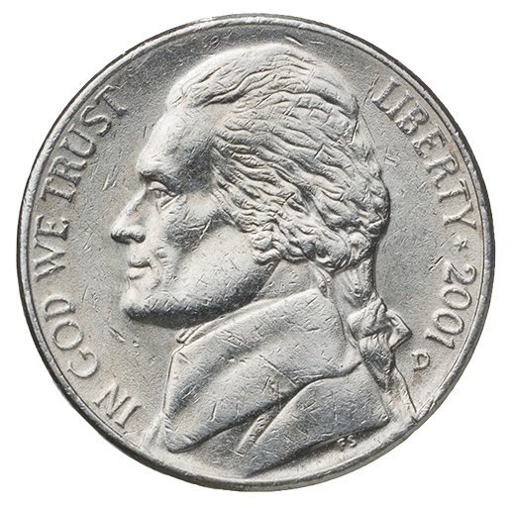
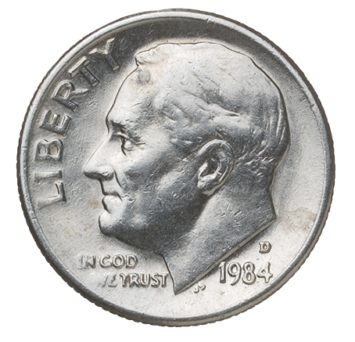
Challenge of the Day
Which has the same value
as 10 pennies?

Slide 3

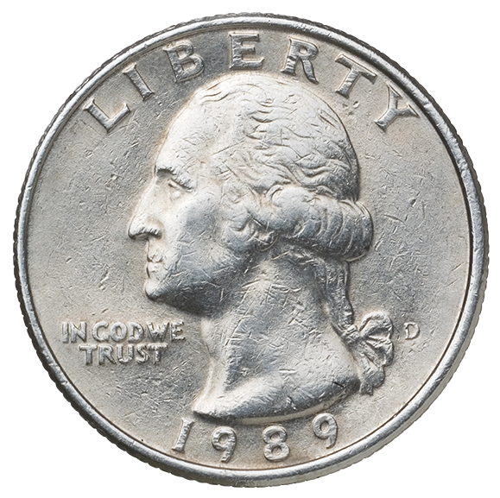
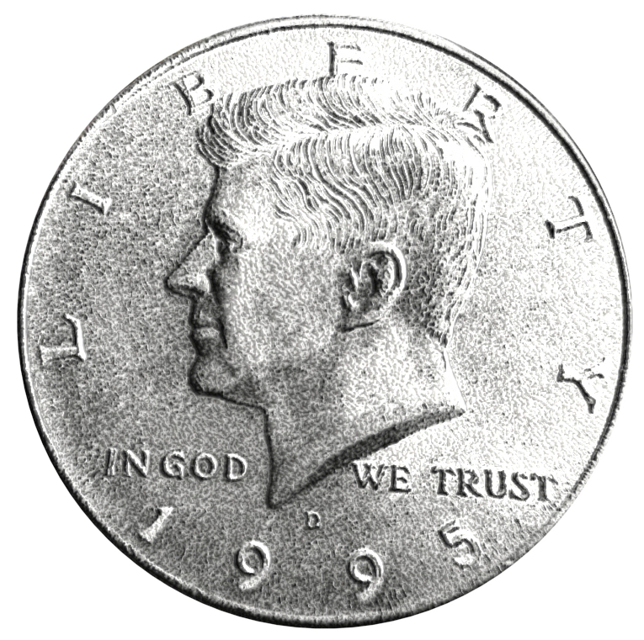
Challenge of the Day
Which has the same value
as 100 pennies?

Slide 4

Challenge of the Day
If you have 3 quarters and 1 nickel, how many cents do you have?

Slide 5
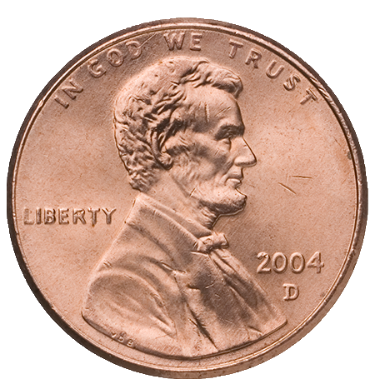
Challenge of the Day
Add the coins.

Slide 6
Challenge of the Day
Cole has 1 half-dollar, 3 dimes,
1 nickel, and 3 pennies.
How much money does he have?

Slide 7
Challenge of the Day
Isla looked under the couch
and found 1 dime, 3 nickels,
and 17 pennies. How much
did she find in all?

Slide 8
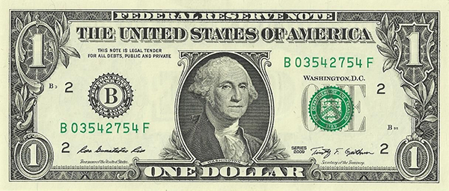
Challenge of the Day
Add the dollar and coins.

Slide 9
Challenge of the Day
If you have 1 dollar bill, 2 quarters,
8 dimes, and 3 nickels, how much money do you have?

Slide 10
Challenge of the Day
Malcolm has 2 dollar bills, a half-dollar, 3 quarters, and 4 pennies. How much money does he have?

Slide 11
Challenge of the Day
Which is greater–
2 quarters or 6 dimes?

Slide 12
Challenge of the Day
Which is less–
5 dimes or 5 nickels?

Slide 13
Challenge of the Day
Which is greater–
3 quarters and 2 dimes
or 90 pennies?

Slide 14
Challenge of the Day
Which is less–
2 dimes and 2 nickels or
1 quarter and 1 dime?

Slide 15
Challenge of the Day
List all the ways you can
think of to make 35¢
without using pennies.

Slide 16
Challenge of the Day
List all the ways you can
think of to make 45¢
without using pennies.

Slide 17
Challenge of the Day
How can you make 70¢ using
the least number of coins?

Slide 18
Challenge of the Day
How can you make 98¢ using
the least number of coins?

Slide 19
Challenge of the Day
A pizza eraser costs 25¢.
Do you have enough to buy it?

Slide 20
Challenge of the Day
Miriam wants to buy a pop-it fidget toy
for $3.99. Does she have enough?

Slide 21
Challenge of the Day
A candy bar costs 70¢.
You pay with 3 quarters.
What is your change?

Slide 22
Challenge of the Day
How much more do you
need to make $1?

Slide 23
Challenge of the Day
A hamburger costs $2.99. You pay with a $5 bill. You get $3 dollar bills and a penny back. Did you get the right amount of change?

Slide 24
Challenge of the Day
Lollipops cost 15¢ each. Hazel has $1. How many lollipops can she buy?

Slide 25
Challenge of the Day
How many squishy pigs can
you buy with $2 if squishy pigs
cost 79¢ each?

Slide 26
Challenge of the Day
How much is 20¢, 25¢, and 39¢
all together?

Slide 27
Challenge of the Day
Myland has 37¢. Teagan has 45¢. How much do they have together?

Slide 28
Challenge of the Day
What is 15¢ less than 28¢?

Slide 29
Challenge of the Day
Norah has 68¢. Kayden has 82¢.
How much more does Kayden
have than Norah?

Slide 30
Challenge of the Day
If you make $5 every day
walking dogs, how much will
you have after 5 days?

Slide 31
Challenge of the Day
Joe has $20. He spent $4 on a hot dog, $3 on fries, and $2 on a drink. How much money does he have left over?

